Slide 1

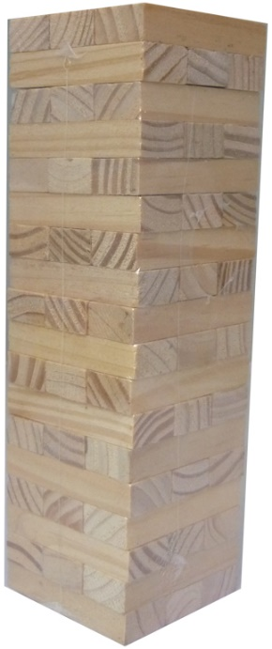

AUA
Building
Behaviours
Instructions and Rules:
Build the tower with three blocks to each level as
pictured, with the blocks in random order.
Each block has a number relating to one of the nine
AUA Professional Behaviours on it. Use the Wheel
on the back of these instructions as the key for
where to look in the AUA CPD Framework.
Decide who goes first and then take even turns.
On your turn, remove a block from the tower (not from top row) and check which one of the nine Behaviours it is.
When it comes back to your turn, before you pick another block, using the block you have just picked, give a work-related example for one of the descriptors from the four sections of that block’s Behaviour on the AUA CPD Framework (30 seconds max wait).
If you give an example you keep the block. If you can’t give an example, the block goes back on to the top of the tower. After this, you can pick another block. It is now the next players turn.
Whoever has the most blocks when the tower falls, wins. Knocking the tower down costs two blocks from your pile.
After the tower falls, if anyone has an example for a block they haven’t shared they should do so, keeping the block if they do.
Tip: make brief notes about what you and other players say for anything you may want to remember or follow up after the game.

Slide 2


AUA
Building
Behaviours
1
9
2
8
3
7
4
6
5
Developed by
Michael Monaghan
M.A.Monaghan@ljmu.ac.uk

