Slide 1

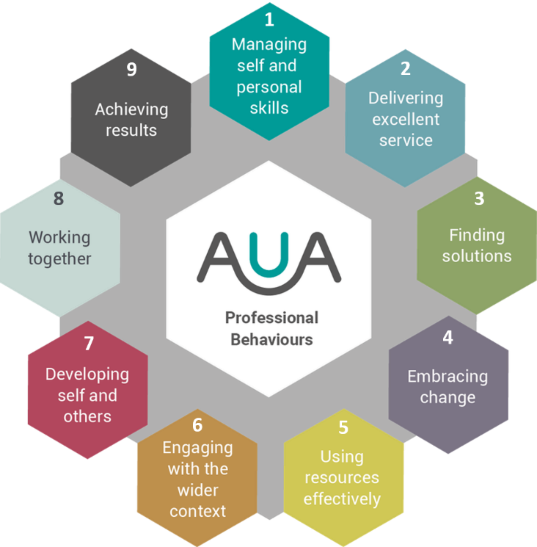

Managing Self and Personal Skills
Delivering Excellent Service
Finding Solutions
Embracing Change
1
2
3
4
Behaviour Insights
Behaviour Insights
Behaviour Insights
Behaviour Insights
Using Resources Effectively
Engaging with the Wider Context
Developing Self and Others
Working Together
5
6
7
8
Behaviour Insights
Behaviour Insights
Behaviour Insights
Behaviour Insights
Insights Board
Achieving Results
9
Behaviour Insights
Behaviour Insights

